Slide 1



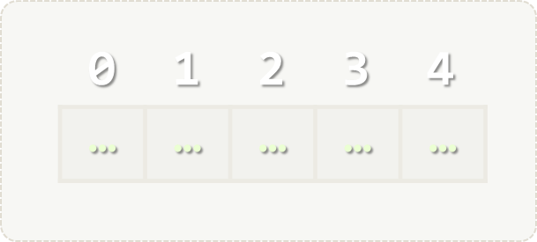
Arrays
Simple Array Processing
Arrays
SoftUni Team
Technical Trainers
Software University
http://softuni.bg

Slide 2

Table of Contents
Defining, Initializing and Processing Arrays
Value vs Reference Types
Reading and Printing Arrays

Slide 3
Questions?
sli.do #extended-softuni

Slide 4
Value vs Reference Types
Memory Stack and Heap

Slide 5
Value types
List of Value Types - https://msdn.microsoft.com/en-us/library/bfft1t3c.aspx
Variables of value types directly contain their data.
With value types, each variable has its own copy of the data, and it is not possible for operations on one variable to affect the other

Slide 6
Reference types
Some of the reference types – string, DateTime, TimeSpan, Random, any other classes, interfaces, delegates and more.
Variables of reference types store references to their data.
With reference types, two variables can reference the same object; therefore, operations on one variable can affect the object referenced by the other variable.

Slide 7
Value vs Reference Types

Slide 8
Example: Value Types
public static void Main(string[] args)
{
int num = 5;
Increment(num, 15);
Console.WriteLine(num);
}
private static void Increment(int num, int value)
{
num += value;
}

Slide 9
Example: Reference Types
public static void Main(string[] args)
{
int[] nums = { 5 };
Increment(nums, 15);
Console.WriteLine(nums[0]);
}
private static void Increment(int[] nums, int value)
{
nums[0] += value;
}

Slide 10
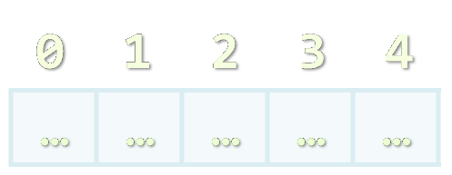
Arrays
Working with Arrays of Elements

Slide 11
What are Arrays?
In programming, array is a sequence of elements
Elements are numbered from 0 to Length-1
Elements are of the same type (e.g. integers)
Arrays have fixed size (Array.Length) – cannot be resized
0 1 2 3 4
Element index
Array of 5 elements
… | … | … | … | …
Element of an array

Slide 12
Working with Arrays
All elements are initially == 0
Allocating an array of 10 integers:
Assigning values to the array elements:
Accessing array elements by index:
int[] numbers = new int[10];
The Length holds the number of array elements
for (int i = 0; i < numbers.Length; i++)
numbers[i] = 1;
The [] operator accesses elements by index
numbers[5] = numbers[2] + numbers[7];
numbers[10] = 1; // IndexOutOfRangeException

Slide 13
Example: Days of Week
The days of week can be stored in array of strings:
string[] days = {
"Monday",
"Tuesday",
"Wednesday",
"Thursday",
"Friday",
"Saturday",
"Sunday"
};
Expression | Value
days[0] | Monday
days[1] | Tuesday
days[2] | Wednesday
days[3] | Thursday
days[4] | Friday
days[5] | Saturday
days[6] | Sunday

Slide 14
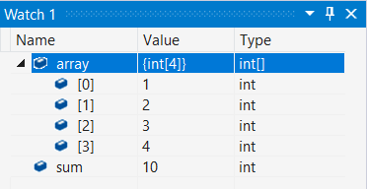
Problem: Sum Array Elements
Read an array of integers and calculate their sum
Check your solution here: https://judge.softuni.bg/Contests/Practice/Index/384#0

Slide 15
Solution: Sum Array Elements
var numberOfElements = int.Parse(Console.ReadLine());
var array = new int[numberOfElements];
for (int i = 0; i < array.Length; i++)
array[i] = int.Parse(Console.ReadLine());
var sum = 0;
for (int i = 0; i < array.Length; i++)
sum += array[i];
Console.WriteLine(sum);
Check your solution here: https://judge.softuni.bg/Contests/Practice/Index/384#0

Slide 16

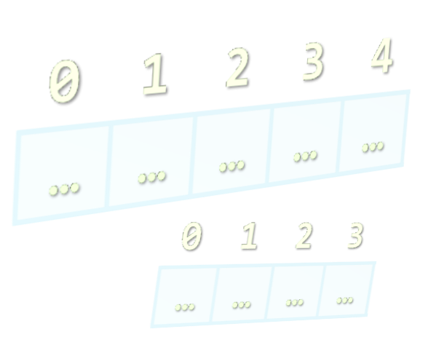
Reading and Printing Arrays
Using String.Split() and for loops

Slide 17
Reading Arrays From the Console
First, read the array length from the console:
Next, create an array of given size n and read its elements:
int n = int.Parse(Console.ReadLine());
int[] arr = new int[n];
for (int i = 0; i < n; i++)
{
arr[i] = int.Parse(Console.ReadLine());
}

Slide 18
Reading Array Values From a Single Line
Arrays can be read from a single line of space separated values:
2 8 30 25 40 72 -2 44 56
string.Split(' ') splits string by space and produces string[]
string values = Console.ReadLine();
string[] items = values.Split(' ');
int[] arr = new int[items.Length];
for (int i = 0; i < items.Length; i++)
arr[i] = int.Parse(items[i]);

Slide 19
Printing Arrays on the Console
To print all array elements, a for-loop can be used
Separate elements with white space or a new line
Example:
string[] arr = {"one", "two", "three", "four", "five"};
// Process all array elements
for (int index = 0; index < arr.Length; index++)
{
// Print each element on a separate line
Console.WriteLine("arr[{0}] = {1}", index, arr[index]);
}

Slide 20
Problem: Multiply an Array of Doubles
Read an array of real numbers (space separated values) and a real number p
Multiply all array elements by p
Print the multiplied elements (on a single line, space separated):
1.2 3.0 12.3 4.56
4
4.8 12 49.2 18.24
6.0 8.8 1.2 -9.6
0.5
3 4.4 0.6 -4.8
Check your solution here: https://judge.softuni.bg/Contests/Practice/Index/384#1

Slide 21
Solution: Multiply an Array of Doubles
var stringArr = Console.ReadLine().Split();
var arr = new double[stringArr.Length];
for (int i = 0; i < arr.Length; i++)
arr[i] = double.Parse(stringArr[i]);
var p = double.Parse(Console.ReadLine());
for (int i = 0; i < arr.Length; i++)
arr[i] *= p;
for (int i = 0; i < arr.Length; i++)
Console.Write(arr[i] + " ");
split the input string by space
convert strings to double
multiply array elements by p
print multiplied array
Check your solution here: https://judge.softuni.bg/Contests/Practice/Index/384#1

Slide 22
Problem: Smallest Element in Array
Read an array of integers (space separated values), find the smallest element and print it:
1 2 3 4
1
3 2 9 -9 6 1
-9
-6 0 -17 -1
-17
Check your solution here: https://judge.softuni.bg/Contests/Practice/Index/384#4

Slide 23
Solution: Smallest Element in Array
var stringArray = Console.ReadLine().Split();
var array = new int[stringArray.Length];
for (int i = 0; i < array.Length; i++)
array[i] = int.Parse(stringArray[i]);
var smallest = int.MaxValue;
for (int i = 0; i < array.Length; i++)
if (array[i] < smallest)
smallest = array[i];
Console.WriteLine(smallest);
if we start at 0 instead of MaxValue, we won’t catch positive numbers
Check your solution here: https://judge.softuni.bg/Contests/Practice/Index/384#4

Slide 24
Printing Arrays with foreach / String.Join(…)
Use foreach-loop:
Use string.Join(separator, array):
int[] arr = { 10, 20, 30, 40, 50};
foreach (var element in arr)
Console.WriteLine(element)
int[] arr = { 1, 2, 3 };
Console.WriteLine(string.Join(", ", arr)); // 1, 2, 3
string[] strings = { "one", "two", "three", "four" };
Console.WriteLine(string.Join(" - ", strings)); // one - two - three - four

Slide 25
Problem: Rotate Array of Strings
Read an array of strings (space separated values), rotate it to the right and print its rotated elements:
Rotating array elements:
a b c d e
e a b c d
soft uni hi
hi soft uni
a
b
c
d
e
Check your solution here: https://judge.softuni.bg/Contests/Practice/Index/384#5

Slide 26
Solution: Rotate Array of Strings
var array = Console.ReadLine().Split().ToArray();
var rotatedArray = new string[array.Length];
for (int i = 0; i < array.Length - 1; i++)
rotatedArray[i + 1] = array[i];
var lastElement = array[rotatedArray.Length - 1];
rotatedArray[0] = lastElement;
Console.WriteLine(string.Join(" ", rotatedArray));
Check your solution here: https://judge.softuni.bg/Contests/Practice/Index/384#5

Slide 27
Problem: Odd Numbers at Odd Positions
Read a list of integers and print the odd numbers at the odd positions (indexes).
2 3 5 2 7 9 -1 -7
5 0 1 2
2 3 55 2 4 1
Index 1 -> 3
Index 5 -> 9
Index 7 -> -7
(no output)
Index 1 -> 3
Index 5 -> 1
Check your solution here: https://judge.softuni.bg/Contests/Practice/Index/384#5

Slide 28
Solution: Odd Numbers at Odd Positions
var stringArray = Console.ReadLine().Split().ToArray();
var array = new string[stringArray.Length];
// Convert string array to int array
for (int i = 0; i < array.Length; i++)
array[i] = int.Parse(stringArray[i]);
for (int i = 0; i < array.Length; i++)
{
if (i % 2 == 1 && Math.Abs(array[i] % 2) == 1)
Console.WriteLine($"Index {i} -> {array[i]}");
}
check for odd index
check for odd element
Check your solution here: https://judge.softuni.bg/Contests/Practice/Index/384#5

Slide 29

Arrays
Live Exercises in Class (Lab)

Slide 30
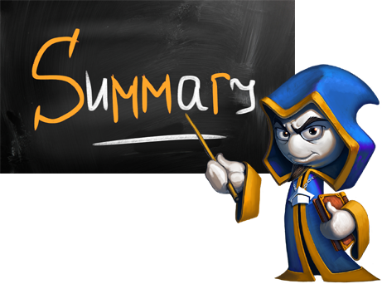
Summary
Arrays hold a sequence of elements
Elements are numbered from 0 to length-1
Creating (allocating) an array:
Accessing array elements by index:
Printing array elements:
int[] numbers = new int[10];
int[] nums = new int[] { 1, 2, 3 };
numbers[5] = 10;
Console.Write(string.Join(" ", arr));

Slide 31








Arrays
https://softuni.bg/courses/programming-fundamentals

Slide 32
License
This course (slides, examples, demos, videos, homework, etc.) is licensed under the "Creative Commons Attribution-NonCommercial-ShareAlike 4.0 International" license
Attribution: this work may contain portions from
"Fundamentals of Computer Programming with C#" book by Svetlin Nakov & Co. under CC-BY-SA license

Slide 33





Trainings @ Software University
Software University Foundation – softuni.org
Software University – High-Quality Education, Profession and Job for Software Developers
softuni.bg
Software University @ Facebook
facebook.com/SoftwareUniversity
Software University Forums – forum.softuni.bg

